Slide 1
STATISTICAL ANALYSIS OF Bank Notes DATA
PRESENTED BY:
Poonam Dhule
(2021-6264
NOIDA)

Slide 2
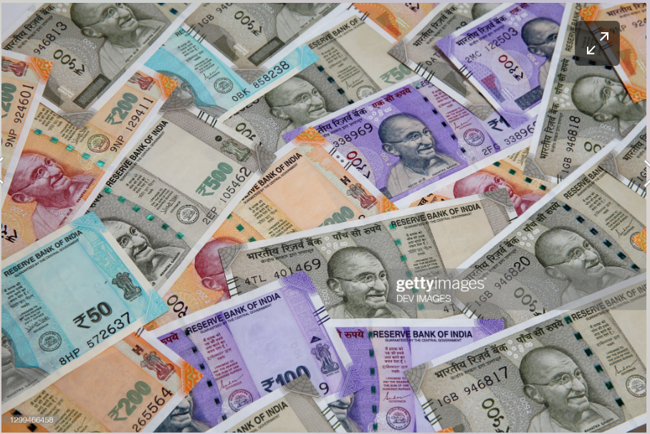

Slide 3
Introduction
The dataset of Bank Notes have 200 different varieties. Data are collected on Six variables were measured (in mm).
The ﬁrst 100 observations are from genuine notes and the remaining observations are from forged banknotes. Consider the entire data as a single dataset.

Slide 4
Variables In Data
V1: Length
V2: Left height
V3: Right height
V4: Lower margin
V5: Upper margin
V6: Diagonal

Slide 5
OBJECTIVE
To identify hidden pattern in a data set.
To reduce the dimensionality of the data by removing the noise and redundancy in the data.
To identify correlated variables

Slide 6
Data Analysis :
For this study, Principal Component Analysis (PCA) has been used to identify which notes are genuine and which one are Froud at various principal component levels.
It is a technique to transform the original set of variables into a smaller set independent linear combinations so that most of the variations in the original data set is explained by those linear combinations. The linear combinations so selected are called Principal Components.
The main purpose of this analysis is to reduce the number of variables into a few ones that can explain most of the variance of the original data set.

Slide 7
Principal component analysis (PCA)
Principal Component Analysis, or PCA, is a dimensionality-reduction method that is often used to reduce the dimensionality of large data sets, by transforming a large set of variables into a smaller one that still contains most of the information in the large set.
PCA helps to interpret your data. simplifies the complexity in high-dimensional data while retaining trends and patterns. It does this by transforming the data into fewer dimensions, which act as summaries of features.

Slide 8
Eigenvalues / eigenvectors
Eigenvalues : The numbers on the diagonal of the diagonalized covariance matrix are called eigenvalues of the covariance matrix. Large eigenvalues correspond to large variances.
Eigenvectors : The directions of the new rotated axes are called the eigenvectors of the covariance matrix.
Eigenvalues and eigenvectors can be easily calculated in R as follow :

Slide 9
Eigen values
[1] 2.98530335 0.93094242 0.24219664 0.19368545 0.08478579 0.03533710
#Looking at the eigenvalues, two PCs are required to explain 90% of the variation.
Eigen vector
[,1] [,2] [,3] [,4] [,5] [,6]
[1,] -0.04377427 0.01070966 -0.3263165 0.5616918 0.75257278 0.09809807
[2,] 0.11216159 0.07144697 -0.2589614 0.4554588 -0.34680082 -0.76651197
[3,] 0.13919062 0.06628208 -0.3447327 0.4153296 -0.53465173 0.63169678
[4,] 0.76830499 -0.56307225 -0.2180222 -0.1861082 0.09996771 -0.02221711
[5,] 0.20176610 0.65928988 -0.5566857 -0.4506985 0.10190229 -0.03485874
[6,] -0.57890193 -0.48854255 -0.5917628 -0.2584483 -0.08445895 -0.04567946
#from eigen vector we can see that from first 2 PCs , Lower Margin and Upper Margin variables seem to be the most important.

Slide 10
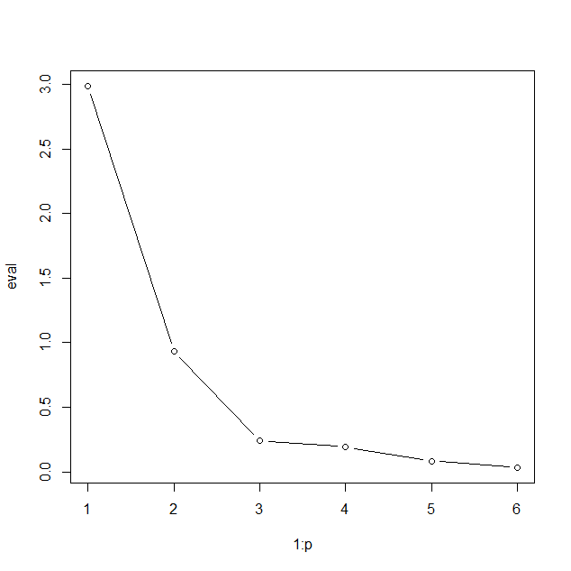

Slide 11
SCREE PLOT
From Scree plot we can see that first 3 principal componants are required to explain 90% of the variation.

Slide 12
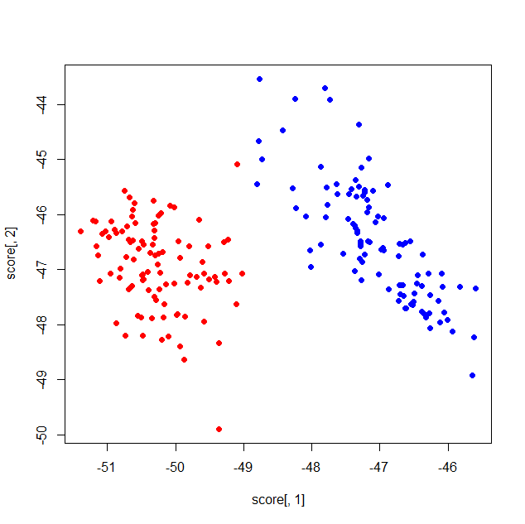

Slide 13
SCORE PLOT
From the score plot we can see clearly that , the two groups are fairly distinguishable with a handful of outliers.

Slide 14
Advantages of PCA:
Easy to compute. PCA is based on linear algebra, which is computationally easy to solve by computers.
Speeds up other machine learning algorithms.
Counteracts the issues of high-dimensional data.

Slide 15
Disadvantages of PCA:
It may lead to some amount of data loss.
PCA tends to find linear correlations between variables, which is sometimes undesirable.
PCA fails in cases where mean and covariance are not enough to define datasets.

Slide 16
conclusion
We can conclude from the Scree plot we can see that first 3 principal components are required to explain 90% of the variation.
From the score plot we can see clearly that , the two groups are fairly distinguishable with a handful of outliers.
So we reduce the dimension and identified the pattern of data.

Slide 17
Thank you

